Slide 1
Cryptography
A non cryptic presentation (hopefully)

Slide 2

Cryptography (from Ancient Greek, cruptos = “hidden”, graphein = “secret”) is the study of techniques for preventing third parties from reading or manipulating private messages.

Slide 3
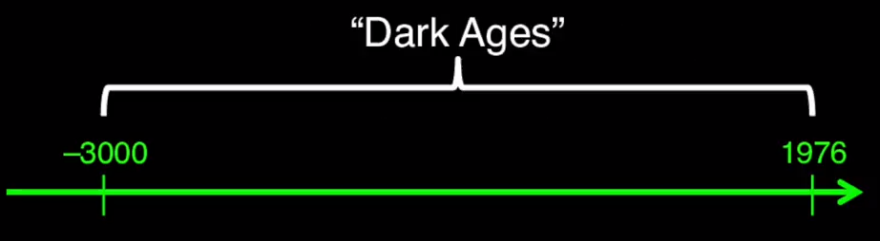
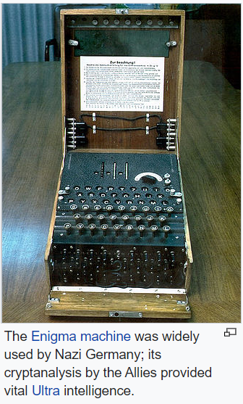
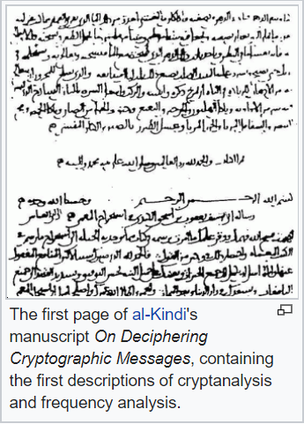
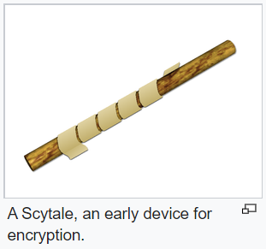
Brief history of cryptography
Initial purpose: To protect military and diplomatic communication
Been around for a loong time…

Slide 4
Cryptography everywhere
Secure network communication (TLS/SSL)
Authentication and digital signatures
Contactless
Block chain technology
Bank / credit cards
Hard disk encryption
GSM
E-mail, FTP, biometry, etc…

Slide 5

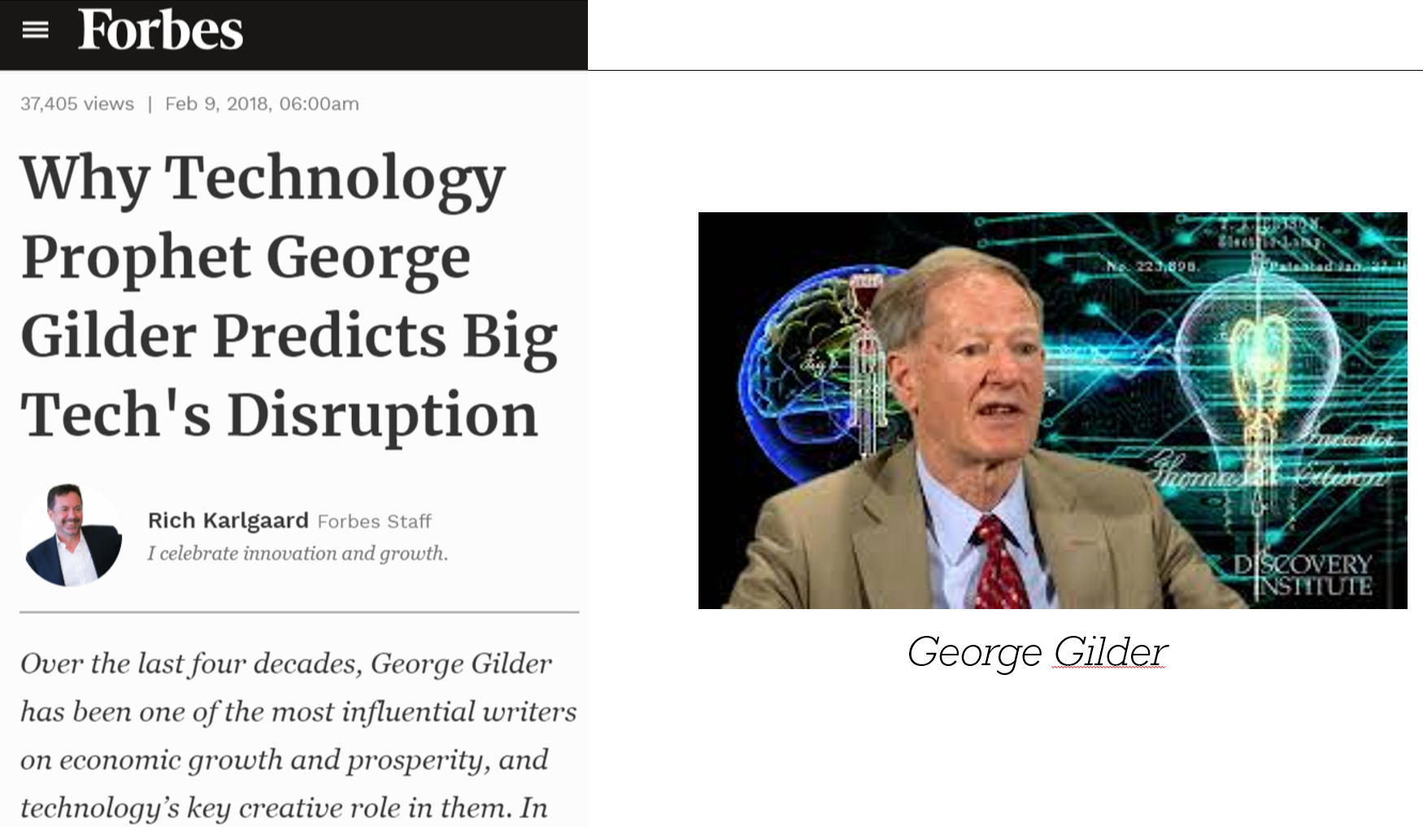
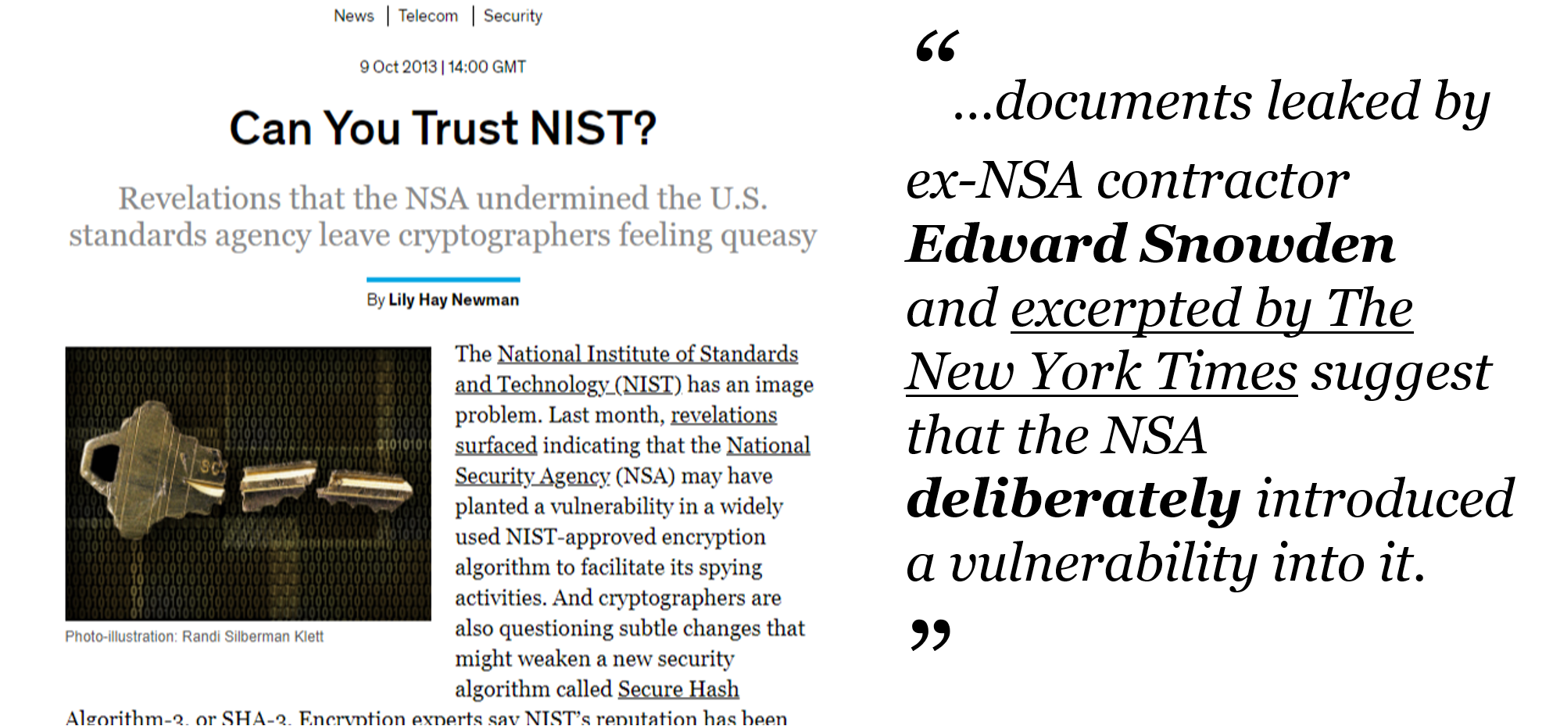
But it doesn’t end there…
Cryptography is changing the world!

Slide 6
Sounds complicated?
Actually it all boils down to three simple concepts

Slide 7

Three concepts
Hashing
Encryption
Symmetric
Asymmetric
Signatures
Always asymmetric

Slide 8
Hashing

Slide 9
Cryptographic hash function
Input
Digest
#
Fox
DFCD 3454 BBEA 788A 751A 696C 24D9 7009 CA99 2D17
The red fox jumps over the blue dog
0086 46BB FB7D CBE2 823C
ACC7 6CD1 90B1 EE6C 3ABC
The red fox jumps ouer the blue dog
8FD8 7558 7851 4F32 D1C6
76B1 79A9 0DA4 AEFE 4819
The red fox jumps oevr the blue dog
FCD3 7FDB 5AF2 C6FF 915F
D401 C0A9 7D9A 46AF FB45
The red fox jumps oer the blue dog
8ACA D682 D588 4C75 4BF4
1799 7D88 BCF8 92B9 6A6C

Slide 10
Demo!
Cryptographic hash function with .Net Core
Using the SHA-2 (aka SHA-256) algorithm

Slide 11

Three concepts
Hashing
Encryption
Symmetric
Asymmetric
Signatures
Always asymmetric

Slide 12
Encryption

Slide 13
Encryption
Send information to a recipient that can’t be enterpreted unless having access to a key
Encryption always consist of two parts, an algorithm and a key

Slide 14
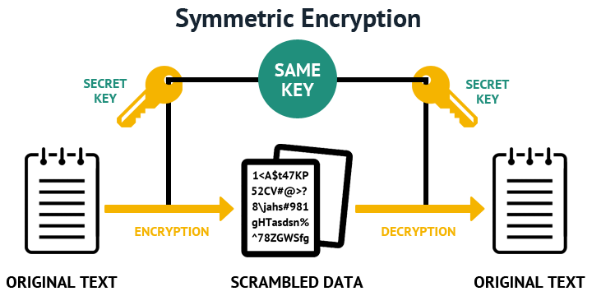
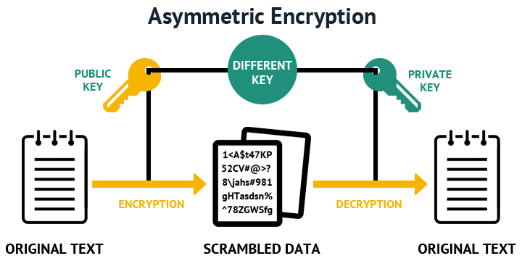

Slide 15
Symmetric
Asymmetric
Same key for encryption and decryption
Sender and reciever have access to the same key
Two different keys are used, public and private (key pair)
Sender encrypts with public, and reciever decrypts with private key

Slide 16



Symmetric encryption
Unencrypted message
Encrypted message
Unencrypted message
To be or not to be, that is the question, whether tis nobler in the…
@#$ȴ˲๲JńǈK{ôĂűȲ^$ȴʎűσ˥͔ŭ̕˰#$ȴ˲๲*JńǈK{ô%űȲ^$ȴʎűσ˥͔ŭ̕˰@#$ȴ˲๲JńǈK{ôĂű&^$
To be or not to be, that is the question, whether tis nobler in the…
Encryption algorithm
Decryption algorithm
Single key

Slide 17
Demo!
Symmetric encryption with .Net Core
Using the AES algorithm

Slide 18
Three concepts
Hashing
Encryption
Symmetric
Asymmetric
Signatures
Always asymmetric

Slide 19




Asymmetric encryption
Sender
Receiver
Unencrypted message
Encrypted message
Unencrypted message
To be or not to be, that is the question, whether tis nobler in the…
@#$ȴ˲๲JńǈK{ôĂűȲ^$ȴʎűσ˥͔ŭ̕˰#$ȴ˲๲*JńǈK{ô%űȲ^$ȴʎűσ˥͔ŭ̕˰@#$ȴ˲๲JńǈK{ôĂű&^$
To be or not to be, that is the question, whether tis nobler in the…
Encryption algorithm
Decryption algorithm
Receivers public key
Receivers private key

Slide 20
Asymmetric encryption (Public-key encryption)
Common algorithms
RSA (by Ron Rivest, Adi Shamir and Len Adleman) from 1977
EC (Elliptic Curve) Neal Koblitz and Victor S. Miller, from 1985, became popular arund 2004
Can be used for both encryption / decryption AND digital signatures
[ - Web demo - ]

Slide 21
Demo!
Asymmetric encryption with .Net Core
Using the RSA algorithm

Slide 22
Three concepts
Hashing
Encryption
Symmetric
Asymmetric
Signatures
Always asymmetric

Slide 23
Signatures

Slide 24
Signatures
Send information to recipients who can verify that the information was sent from a trusted sender, using a public key

Slide 25
Creating and verifying a signature
Sender
Receiver
Message hash
@#$ȴ˲๲JńǈK{ôĂűȲ&^()
hash
Encryption algorithm
Decryption algorithm
Encrypted message digest
Yes
Message transmitted correctly
Equal?
Hash algorithm
Error! Message has been modified
No
Senders private key
Senders public key
Message hash
To be or not to be, that is the question, whether tis nobler in the…
To be or not to be, that is the question, whether tis nobler in the…
Hash algorithm
Message
Message

Slide 26
Demo!
Signatures with .Net Core
Using the RSA algorithm
All code examples are available on GitHub https://github.com/stratiteq/techcomp-crypto

Slide 27
Symmetric vs asymmetric encryption
Symmetric encryption is faster
Suitable when transferring large volumes of data
Asymmetric encryption is more complex, and thus not as fast as symmetric, but is needed for many common use cases
Validation of authenticity by using digital signatures (e.g. authentication tokens)
Exchange keys between sender and reciever, which is an important part of SSL/TLS communication

Slide 28

Three concepts
Hashing
Encryption
Symmetric
Asymmetric
Signatures
Always asymmetric
All crypto based features uses one or combinations of these simple concepts!

Slide 29
Every day cryptography
…we’ve all used

Slide 30




TLS/SSL
Token authentication
Blockchains
Skånetrafiken
tickets

Slide 31

TLS
Used for encryption for all communication between computers on a network (or internet)
HTTPS = HTTP (raw text) + TLS (text has been encrypted)
Combines symmetric and asymmetric encryption

Slide 32
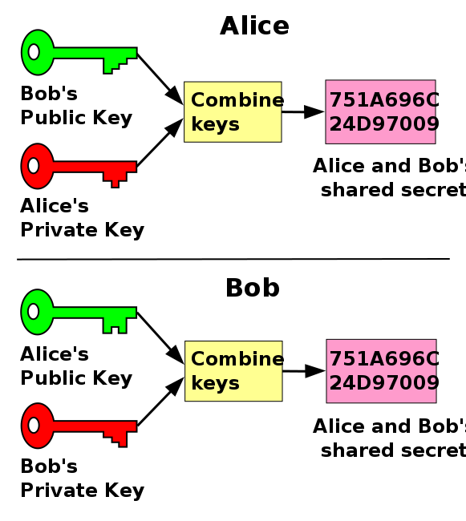
TLS in action
Diffie-Hellman is a key exchanging method:
Alice and Bob generates a key pair each (public and private key)
They send their public keys to each other
They generate a common secret with their own private key and the others public key
They now have a shared key, which they now can use to sending messages with symmetric encryption

Slide 33
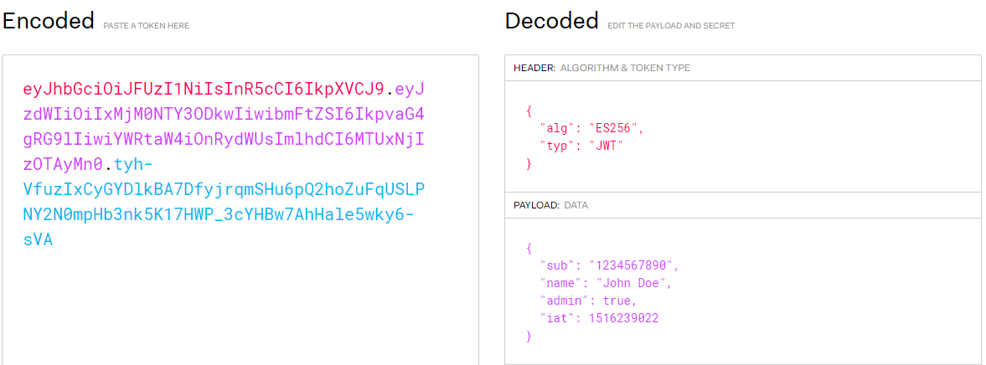
Json Web Tokens

Slide 34
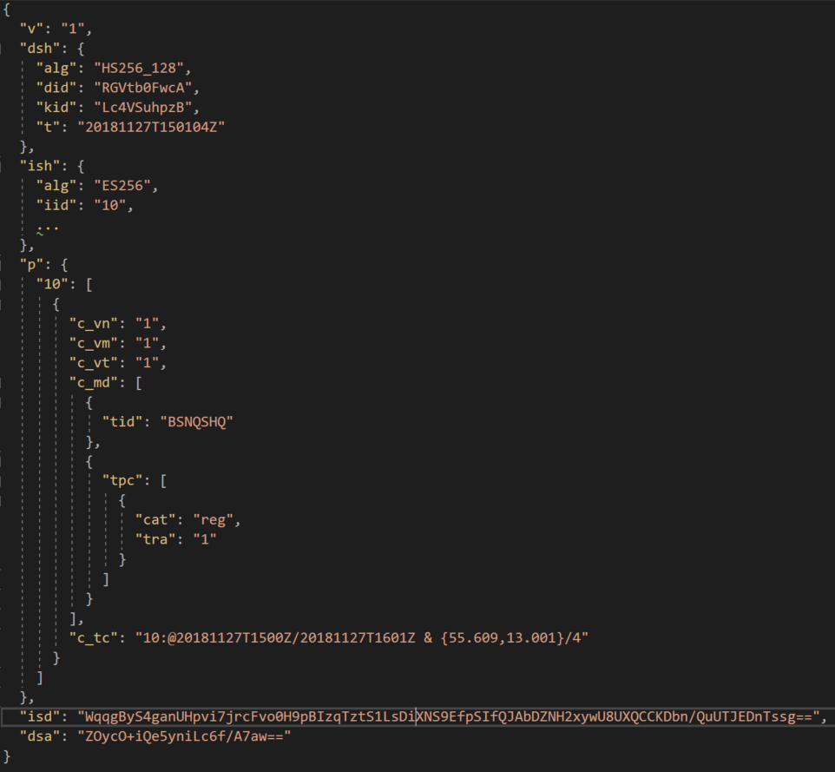
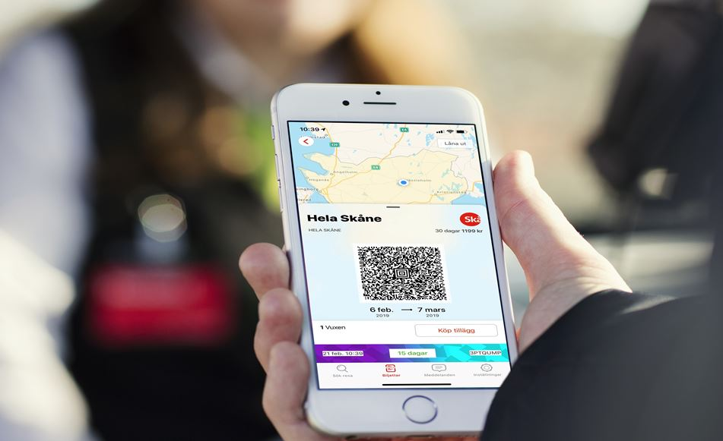

Cryptography in the Skånetrafiken tickets

